Slide 1
CS 5330 Programming Assignment 2
[name]
[NU email]
[NU username]
[NUID]

Slide 2
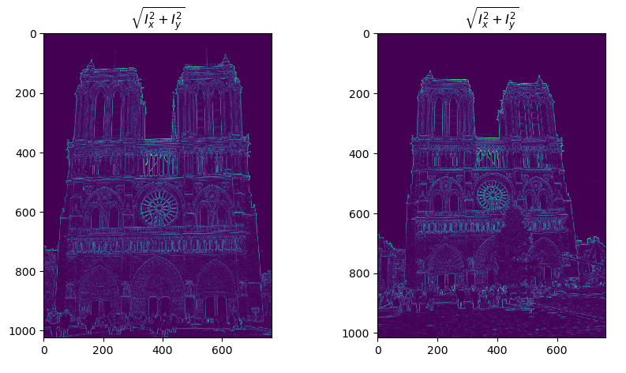
Part 1: Harris corner detector
[insert visualization of \sqrt(I_{x}² + I_{y}²) for Notre Dame image pair from pa2.ipynb here]
[Which areas have highest magnitude? Why?]

Slide 3
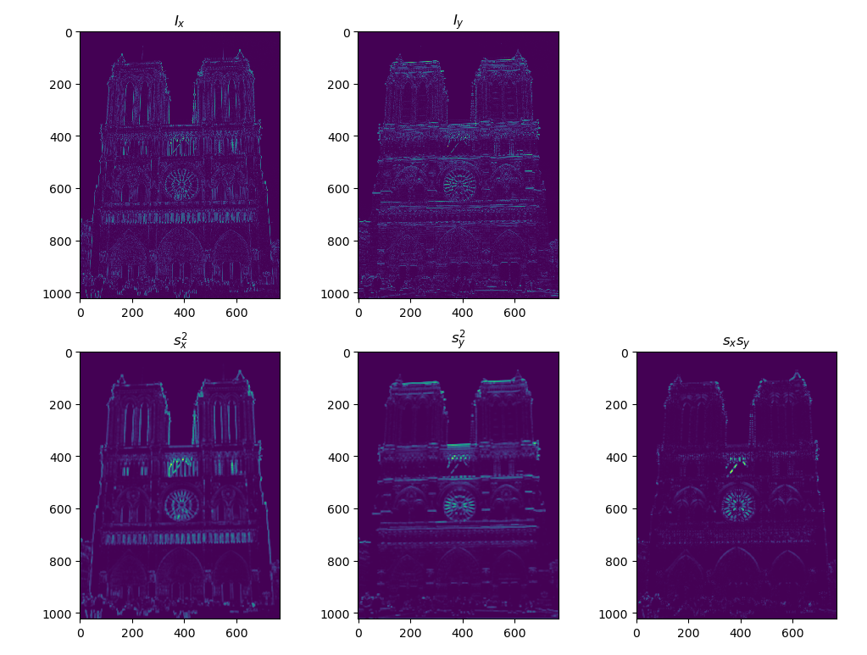
Part 1: Harris corner detector
[insert visualization of I_{x}, I_{y}, s_{x}², s_{y}², s_{x}s_{y} for Notre Dame image pair from pa2.ipynb here]

Slide 4
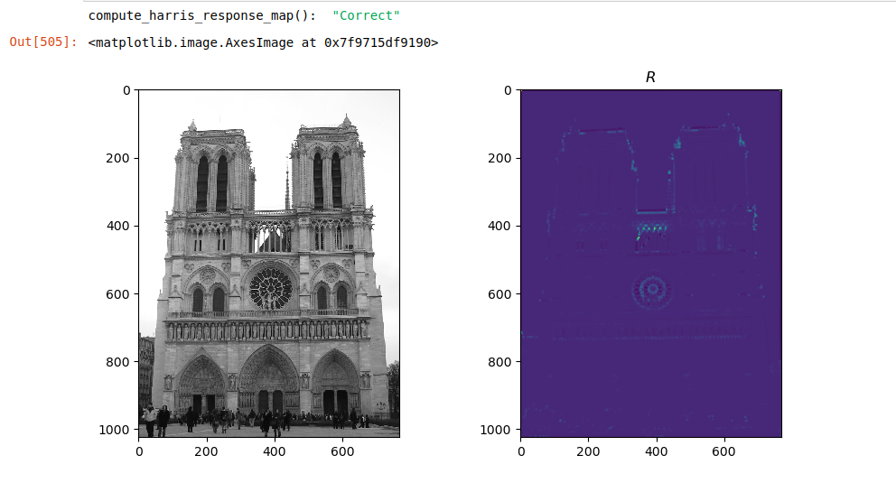
Part 1: Harris corner detector
[insert visualization of corner response map of Notre Dame image from pa2.ipynb here]
[Are gradient features invariant to both additive shifts (brightness) and multiplicative gain (contrast)? Why or why not? See Szeliski Figure 3.2]

Slide 5
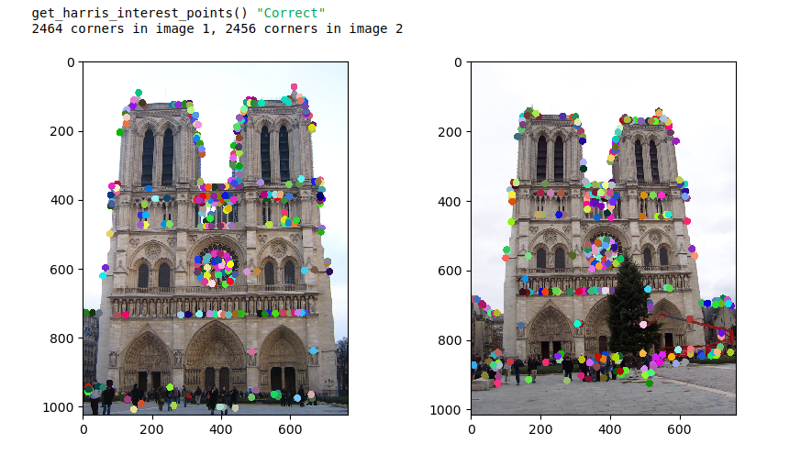
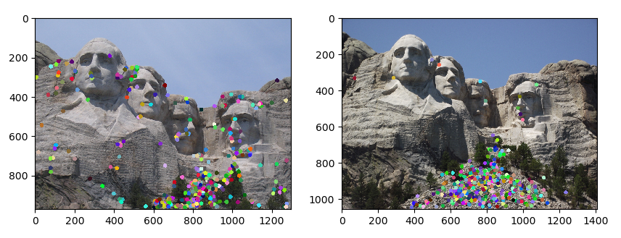
Part 1: Harris corner detector
[insert visualization of Notre Dame interest points from pa2.ipynb here]
[insert visualization of Mt. Rushmore interest points from pa2.ipynb here]

Slide 6
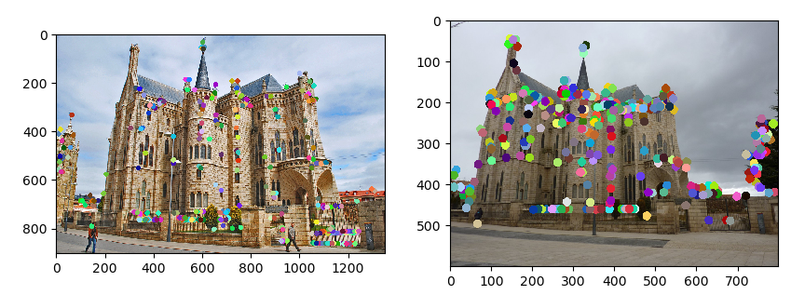
Part 1: Harris corner detector
[insert visualization of Gaudi interest points from pa2.ipynb here]
[What are the advantages and disadvantages of using maxpooling for non-maximum suppression (NMS)?]

Slide 7
Part 1: Harris corner detector
[What is your intuition behind what makes the Harris corner detector effective?]

Slide 8
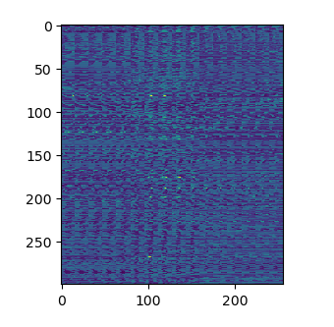
Part 2: Normalized patch feature descriptor
[insert visualization of normalized patch descriptor from pa2.ipynb here]
[Why aren't normalized patches a very good descriptor?]

Slide 9
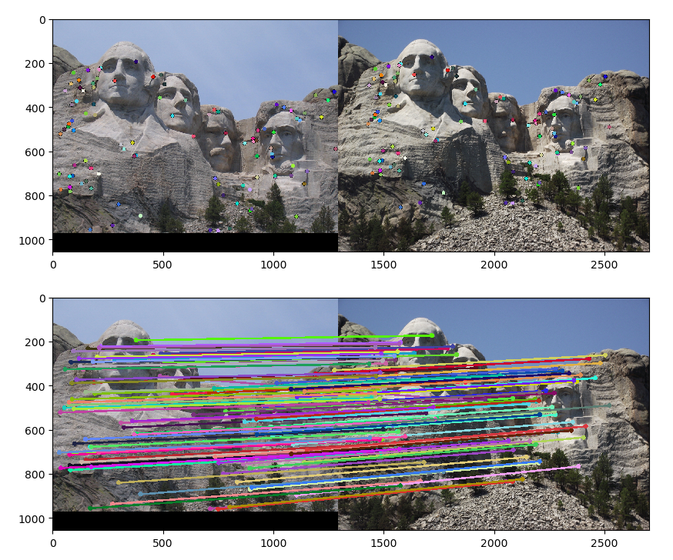
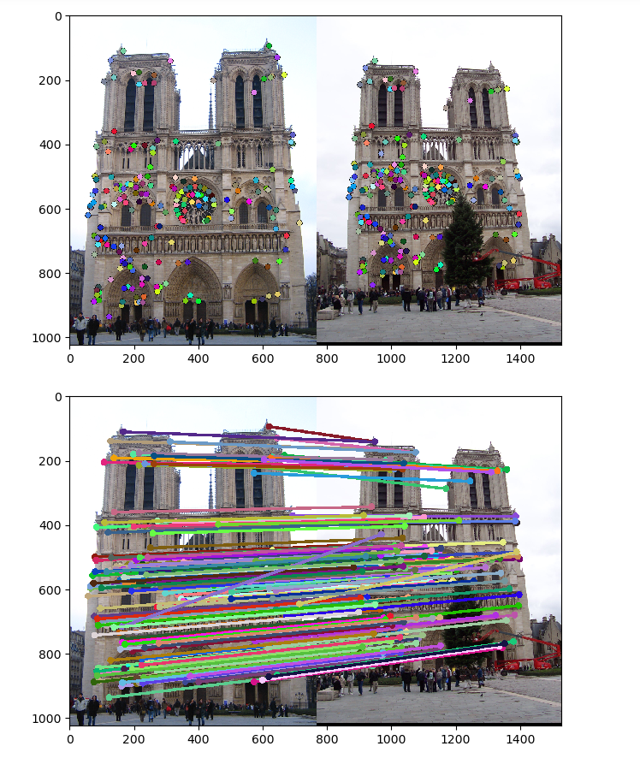
Part 3: Feature matching
[insert visualization of matches (with green/red lines for correct/incorrect correspondences) for Notre Dame image pair from pa2.ipynb here]
# matches (out of 100): [95]
Accuracy: [87]
[insert visualization of matches for Mt. Rushmore image pair from pa2.ipynb here]
# matches: [91]
Accuracy: [83]

Slide 10
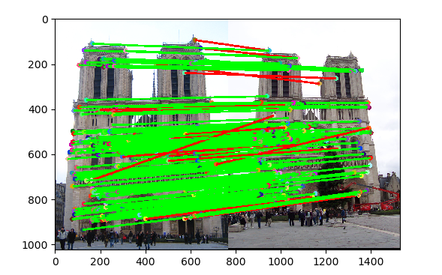
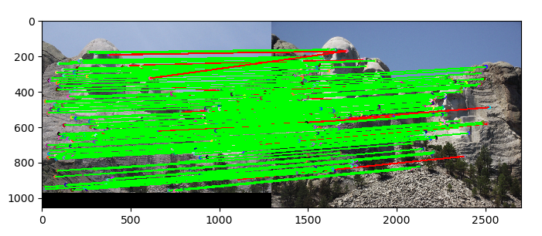
Part 3: Feature matching
[insert visualization of matches (with green/red lines for correct/incorrect correspondences) for Notre Dame image pair from pa2.ipynb here]
# matches (out of 100): [91]
Accuracy: [0.91]
[insert visualization of matches for Mt. Rushmore image pair from pa2.ipynb here]
# matches: [96]
Accuracy: [.96]

Slide 11
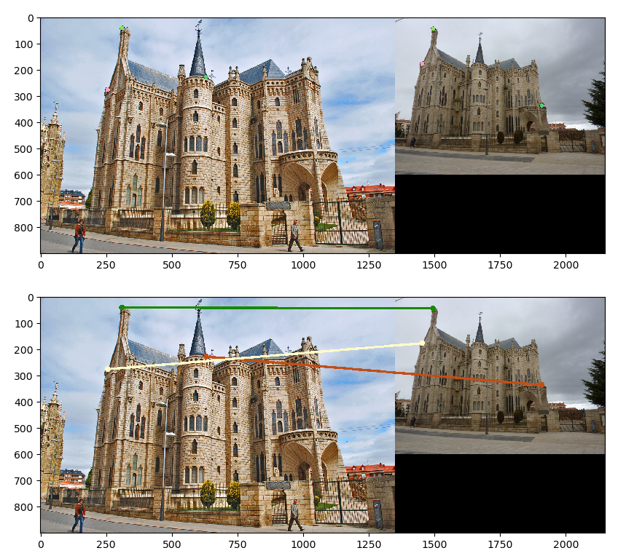
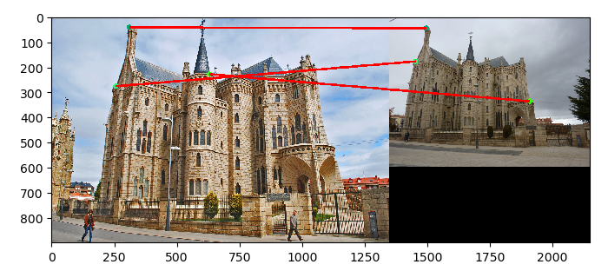
Part 3: Feature matching
[insert visualization of matches for Gaudi image pair from pa2.ipynb here]
# matches: [3]
Accuracy: [0.01]
[Describe your implementation of feature matching here]

Slide 12
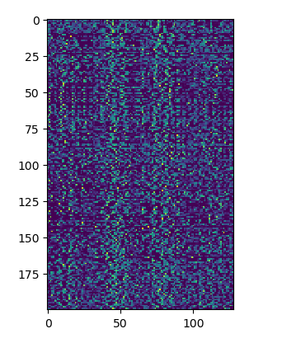
Part 4: SIFT feature descriptor
[insert visualization of SIFT feature descriptor from pa2.ipynb here]
[insert visualization of matches (with green/red lines for correct/incorrect correspondences) for Notre Dame image pair from pa2.ipynb here]
# matches (out of 100): [insert # matches here]
Accuracy: [insert accuracy here]

Slide 13
Part 4: SIFT feature descriptor
[insert visualization of matches for Mt. Rushmore image pair from pa2.ipynb here]
# matches: [insert # matches here]
Accuracy: [insert accuracy here]
[insert visualization of matches for Gaudiimage pair from pa2.ipynb here]
# matches: [insert # matches here]
Accuracy: [insert accuracy here]

Slide 14
Part 4: SIFT feature descriptor
[Describe your implementation of SIFT feature descriptors here]
[Why are SIFT features better descriptors than the normalized patches?]

Slide 15
Conclusion
[Why aren't our version of SIFT features rotation- or scale-invariant? What would you have to do to make them so?]

